Slide 1
Network And System Security
Chapter 11: Firewalls
EECS710: Information Security
Professor Hossein Saiedian
Fall 2014
Notes:
Lecture slides prepared for “Computer Security: Principles and Practice”, 1/e, by William Stallings and Lawrie Brown.

Slide 2
Firewalls, Location and configuration
Effective means of protecting LANs
Internet connectivity is essential
  For organization and individuals
  But creates a threat (enabling the outside world to reach and interact with local network assets)
Could secure all workstations and servers (but this is not a practical approach)
Also use firewall as perimeter defence
  Single choke point to impose security
Notes:
Firewalls can be an effective means of protecting a local system or network of systems from network-based security threats while at the same time affording access to the outside world via wide area networks and the Internet. Internet connectivity is no longer optional for organizations. The information and services available are essential to the organization. Moreover, individual users within the organization want and need Internet access, and if this is not provided via their LAN, they will use dial-up capability from their PC to an Internet service provider (ISP). However, while Internet access provides benefits to the organization, it enables the outside world to reach and interact with local network assets. This creates a threat to the organization. While it is possible to equip each workstation and server on the premises network with strong security features, such as intrusion protection, this is not a practical approach. The alternative, increasingly accepted, is the firewall, inserted between the premises network and the Internet to establish a controlled link and to erect an outer security wall or perimeter. The aim of this perimeter is to protect the premises network from Internet-based attacks and to provide a single choke point where security and audit can be imposed.

Slide 3
Firewall Access Policy
A critical component in the planning and implementation of a firewall is specifying a suitable access policy
  Types of traffic authorized to pass through the firewall
  Includes address ranges, protocols, applications and content types
The policy should be developed from the organization’s security risk assessment and policy
Should be developed from a broad specification of which traffic types the organization needs to support
  Then refined to detail the filter elements which can then be implemented within an appropriate firewall topology
Notes:
A critical component in the planning and implementation of a firewall is
specifying a suitable access policy. This lists the types of traffic authorized to pass
through the firewall, including address ranges, protocols, applications and content
types. This policy should be developed from the organization’s information security
risk assessment and policy, that we discuss in Chapters 14 and 15. This policy
should be developed from a broad specification of which traffic types the organization
needs to support. It is then refined to detail the filter elements we discuss next,
which can then be implemented within an appropriate firewall topology.

Slide 4
Firewall Capabilities & Limits
Capabilities
  Defines a single choke point
  Provides a location for monitoring security events
  Convenient platform for some Internet functions such as NAT, usage monitoring, IPSEC, VPNs
Limitations
  Cannot protect against attacks bypassing firewall (from dial-out, or a modem pool dial-in capability for traveling employees and telecommuters)
  May not protect fully against internal threats
  Improperly secure wireless LAN
  Laptop, PDA, portable storage device infected outside then used inside
Notes:
The following capabilities are within the scope of a firewall:
1. A firewall defines a single choke point that keeps unauthorized users out of the protected network, prohibits potentially vulnerable services from entering or leaving the network, and provides protection from various kinds of IP spoofing and routing attacks. The use of a single choke point simplifies security management.
2. A firewall provides a location for monitoring security-related events.
3. A firewall is a convenient platform for several Internet functions that are not security related. These include a network address translator (NAT),, and a network management function that audits or logs Internet usage.
4. A firewall can act as the platform for IPSec to implement virtual private networks.
Firewalls have their limitations, including the following:
1. The firewall cannot protect against attacks that bypass the firewall, e.g. from dial-out, or a modem pool dial-in capability for traveling employees and telecommuters.
2. The firewall may not protect fully against internal threats, such as a disgruntled employee or an employee who unwittingly cooperates with an external attacker.
3. An improperly secured wireless LAN may be accessed from outside the org
4. A laptop, PDA, or portable storage device may be used and infected outside the corporate network and then attached and used internally.

Slide 5
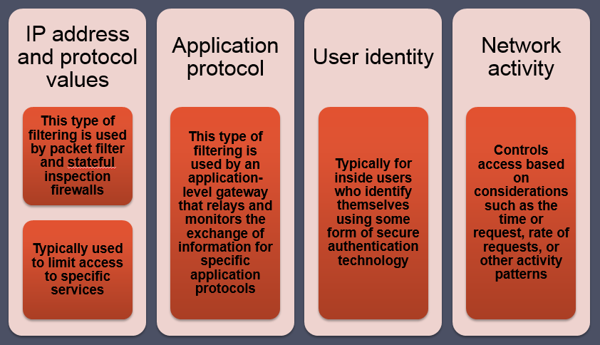
Firewall Filter Characteristics

Slide 6
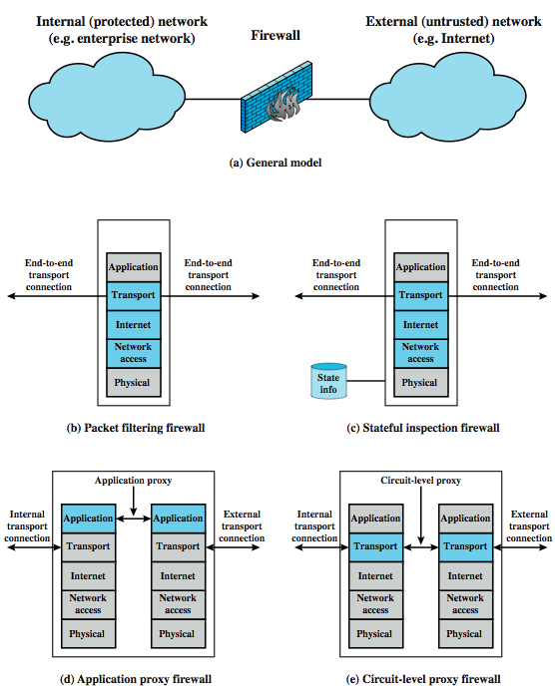
Types of Firewalls
Positive (negative) filter:
Allow (reject) packets that
meet a criteria
Stateful inspection: Keeps track of
TCP connections
Notes:
A firewall may act as a packet filter. It can operate as a positive filter, allowing to pass only packets that meet specific criteria, or as a negative filter,rejecting any packet that meets certain criteria. Depending on the type of firewall, it may examine one or more protocol headers in each packet, the payload of each packet, or the pattern generated by a sequence of packets. In this section, we look at the principal types of firewalls, which include:
Packet Filtering Firewall: applies a set of rules to each incoming and outgoing IP packet and then forwards or discards the packet (Figure 9.1b).
Stateful Inspection Firewalls: reviews the same packet information as a packet filtering firewall, but also records information about TCP connections (Figure 9.1c). May also keep track of TCP sequence numbers to prevent attacks that depend in some fashion on the sequence number, such as session hijacking.
Application-Level Gateway: acts as a relay of application-level traffic (Figure 9.1d). The user contacts the gateway with the name of the remote host to be accessed. When the user responds and provides a valid user ID and authentication information, the gateway contacts the application on the remote host and relays TCP segments containing the application data between the two endpoints.
Circuit-Level Gateway: or circuit-level proxy (Figure 9.1e) determining which connections will be allowed, and if so, sets up two TCP connections, one between itself and a TCP user on an inner host and one between itself and a TCP user on an outside host. Once the two connections are established, the gateway typically relays TCP segments from one connection to the other without examining the contents.

Slide 7
Packet Filtering Firewall
Applies rules to packets in/out of firewall
based on information in packet header
  src/dest IP addr & port, IP protocol, interface
Typically a list of rules of matches on fields
  If match rule says if forward or discard packet
Two default policies:
  Discard: prohibit unless expressly permitted
    more conservative, controlled, visible to users
  Forward: permit unless expressly prohibited
    easier to manage/use but less secure
Notes:
A packet filtering firewall applies a set of rules to each incoming and outgoing IP packet and then forwards or discards the packet. The firewall is typically configured to filter packets going in both directions (from and to the internal network). Filtering rules are based on information contained in a network packet: source IP address, destination IP address, source and destination transport-level address (port number), IP protocol field, interface (on firewall packet came from or is destined for). One advantage of a packet filtering firewall is its simplicity. Also, packet filters typically are transparent to users and are very fast.
The packet filter is typically set up as a list of rules based on matches to fields in the IP or TCP header. If there is a match to one of the rules, that rule is invoked to determine whether to forward or discard the packet. If there is no match to any rule, then a default action is taken. Two default policies are possible:
• Default = discard: That which is not expressly permitted is prohibited.
• Default = forward: That which is not expressly prohibited is permitted.
The default discard policy is more conservative. Initially, everything is blocked, and services must be added on a case-by-case basis. This policy is more visible to users, who are more likely to see the firewall as a hindrance. The default forward policy increases ease of use for end users but provides reduced security; the security administrator must, in essence, react to each new security threat as it becomes known.

Slide 8
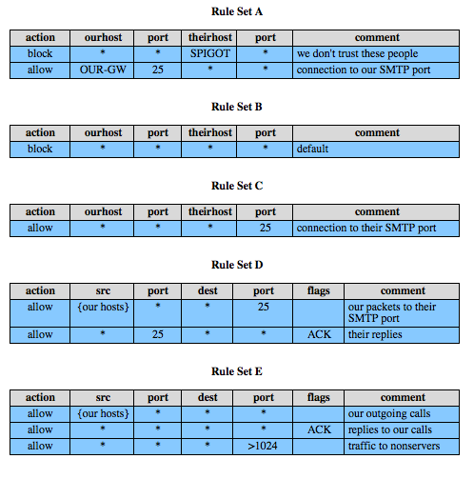
Packet Filter Rules
Default rule (usually
the last rule)
Inside hosts can
send email
A way of handling
FTP
Notes:
Table 9.1, from the text gives some examples of packet filtering rule sets. In each set, the rules are applied top to bottom. The "*" in a field is a wildcard designator that matches everything. We assume that the default = discard policy is in force.
A. Inbound mail is allowed (port 25 is for SMTP incoming), but only to a gateway host. However, packets from a particular external host, SPIGOT, are blocked.
B. This is an explicit statement of the default policy, usually implicitly the last rule.
C. This rule set is intended to specify that any inside host can send mail to the outside. A TCP packet with a destination port of 25 is routed to the SMTP server on the destination machine. Problem is that 25 as SMTP is only a default; an outside machine could be configured to have some other application linked to port 25.
D. This rule set achieves the intended result that was not achieved in C. This rule set allows IP packets where the source IP address is one of a list of designated internal hosts and the destination TCP port number is 25. It also allows incoming packets with a source port number of 25 that include the ACK flag. This takes advantage of a feature of TCP connections that once set up, the ACK flag of a TCP segment is set to acknowledge segments sent from the other side.
E. This rule set is one approach to handling FTP which uses two TCP connections: a control connection and a data connection for the actual file transfer. The data connection uses a different dynamically assigned port number for the transfer. Most servers, and hence most attack targets, live on low-numbered ports; most outgoing calls tend to use a higher-numbered port, typically above 1023. Rule set E points out the difficulty in dealing with applications at the packet filtering level.

Slide 9
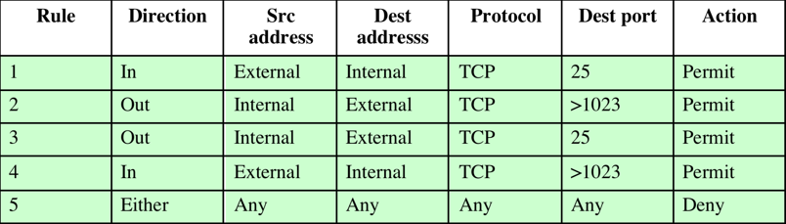
Packet Filter Rules
Notes:
Table 9.1, from the text gives some examples of packet filtering rule sets. In each set, the rules are applied top to bottom. The "*" in a field is a wildcard designator that matches everything. We assume that the default = discard policy is in force.
A. Inbound mail is allowed (port 25 is for SMTP incoming), but only to a gateway host. However, packets from a particular external host, SPIGOT, are blocked.
B. This is an explicit statement of the default policy, usually implicitly the last rule.
C. This rule set is intended to specify that any inside host can send mail to the outside. A TCP packet with a destination port of 25 is routed to the SMTP server on the destination machine. Problem is that 25 as SMTP is only a default; an outside machine could be configured to have some other application linked to port 25.
D. This rule set achieves the intended result that was not achieved in C. This rule set allows IP packets where the source IP address is one of a list of designated internal hosts and the destination TCP port number is 25. It also allows incoming packets with a source port number of 25 that include the ACK flag. This takes advantage of a feature of TCP connections that once set up, the ACK flag of a TCP segment is set to acknowledge segments sent from the other side.
E. This rule set is one approach to handling FTP which uses two TCP connections: a control connection and a data connection for the actual file transfer. The data connection uses a different dynamically assigned port number for the transfer. Most servers, and hence most attack targets, live on low-numbered ports; most outgoing calls tend to use a higher-numbered port, typically above 1023. Rule set E points out the difficulty in dealing with applications at the packet filtering level.

Slide 10
Packet Filter Weaknesses
Weaknesses
  Cannot prevent attack on application bugs
  Limited logging functionality
  Do no support advanced user authentication
  Vulnerable to attacks on TCP/IP protocol bugs (e.g., IP address spoofing)
  Improper configuration can lead to breaches
Attacks
  IP address spoofing
  Source route attacks (srs dictates the pkt route)
  Tiny fragment attacks (to circumvent filtering rules that depend on TCP header info)
Notes:
Some weaknesses of packet filter firewalls:
• Because packet filter firewalls do not examine upper-layer data, they cannot prevent attacks that employ application-specific vulnerabilities or functions.
• Because of the limited info available to the firewall, the logging functionality present in packet filter firewalls the same as used to make access control decisions
• Most packet filter firewalls do not support advanced user authentication schemes.
• They are generally vulnerable to attacks and exploits that take advantage of problems within the TCP/IP specification and protocol stack, such as network layer address spoofing.
• Finally, due to the small number of variables used in access control decisions, packet filter firewalls are susceptible to security breaches caused by improper configurations.
Some of the attacks/countermeasures on packet filtering firewalls are:
• IP address spoofing: The intruder transmits packets from the outside with a source IP address field containing an address of an internal(assumed trusted) host. The countermeasure is to discard external packets with an inside source address
• Source routing attacks: specifies the route that a packet should take as it crosses the Internet. The countermeasure is to discard all packets that use this option.
• Tiny fragment attacks: intruder uses the IP fragmentation option to create extremely small fragments and force the TCP header information into a separate packet fragment, to circumvent filtering rule. It can be defeated by requiring that the first fragment contain most of the transport header.

Slide 11
Stateful Inspection Firewall
Reviews packet header information but also keeps info on TCP connections
  Typically have low, “known” port # for server and high, dynamically assigned (ephemeral) client port #
  Stateful inspection packet firewall tightens rules for TCP traffic using a directory of TCP connections
  only allow incoming traffic to high-numbered ports for packets matching an entry in this directory
  may also track TCP seq numbers as well
Notes:
A traditional packet filter makes filtering decisions on an individual packet basis and does not take into consideration any higher layer context. A Stateful Inspection Firewalls reviews the same packet information but also records information about TCP connections. In general, when an application that uses TCP creates a session with a remote host, it creates a TCP connection in which the TCP port number for the remote (server) application is a number less than 1024 and the TCP port number for the local (client) application is a number between 1024 and 65535. The numbers less than 1024 are the "well-known" port numbers and are assigned permanently to particular applications (e.g., 25 for server SMTP). The numbers between 1024 and 65535 are generated dynamically and have temporary significance only for the lifetime of a TCP connection. A simple packet filtering firewall must permit inbound network traffic on all these high-numbered ports for TCP-based traffic to occur. This creates a vulnerability that can be exploited by unauthorized users. A stateful inspection packet firewall tightens up the rules for TCP traffic by creating a directory of outbound TCP connections, as shown in Table 9.2 in the text. There is an entry for each currently established connection. The packet filter will now allow incoming traffic to high-numbered ports only for those packets that fit the profile of one of the entries in this directory. A stateful packet inspection firewall reviews the same packet information as a packet filtering firewall, but also records information about TCP connections. Some stateful firewalls also keep track of TCP sequence numbers to prevent attacks that depend in some fashion on the sequence number, such as session hijacking.

Slide 12
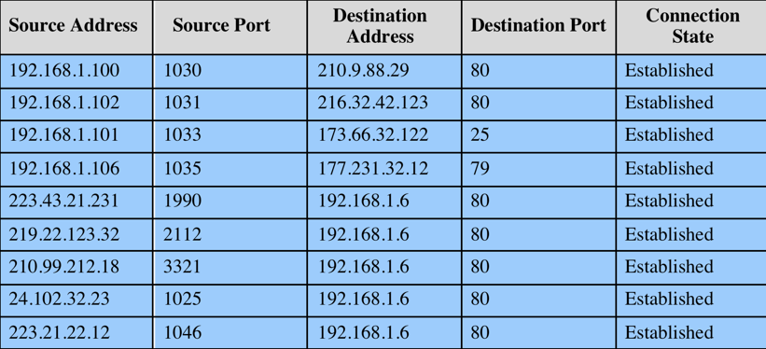
Connection State Table

Slide 13
Application-Level (Proxy) Gateway
Acts as a relay of application-level traffic
  User contacts gateway with remote host name
  Authenticates themselves
  Gateway contacts application on remote host and relays TCP segments between server and user
Must have proxy code for each application
  May restrict application features supported
  Some services may not be available
More secure than packet filters
But have higher overheads
Notes:
An application-level gateway, also called an application proxy, acts as a relay of application-level traffic. The user contacts the gateway using a TCP/IP application, such as Telnet or FTP, and the gateway asks the user for the name of the remote host to be accessed. When the user responds and provides a valid user ID and authentication information, the gateway contacts the application on the remote host and relays TCP segments containing the application data between the two endpoints. If the gateway does not implement the proxy code for a specific application, the service is not supported and cannot be forwarded across the firewall. Further, the gateway can be configured to support only specific features of an application that the network administrator considers acceptable while denying all other features.
Application-level gateways tend to be more secure than packet filters. Rather than trying to deal with the numerous possible combinations that are to be allowed and forbidden at the TCP and IP level, the application-level gateway need only scrutinize a few allowable applications. In addition, it is easy to log and audit all incoming traffic at the application level.
A prime disadvantage of this type of gateway is the additional processing overhead on each connection. In effect, there are two spliced connections between the end users, with the gateway at the splice point, and the gateway must examine and forward all traffic in both directions.

Slide 14
Circuit-Level Gateway
Sets up two TCP connections, to an inside user and to an outside host
Once connection is established, relays TCP segments from one connection to the other without examining contents
  Hence independent of application logic
  Just determines whether relay is permitted
Typically used when inside users trusted
  May use application-level gateway inbound and circuit-level gateway outbound
  Hence lower overheads
Notes:
A fourth type of firewall is the circuit-level gateway or circuit-level proxy (Figure 9.1e). This can be a stand-alone system or it can be a specialized function performed by an application-level gateway for certain applications. As with an application gateway, a circuit-level gateway does not permit an end-to-end TCP connection; rather, the gateway sets up two TCP connections, one between itself and a TCP user on an inner host and one between itself and a TCP user on an outside host. Once the two connections are established, the gateway typically relays TCP segments from one connection to the other without examining the contents. The security function consists of determining which connections will be allowed.
A typical use of circuit-level gateways is a situation in which the system administrator trusts the internal users. The gateway can be configured to support application-level or proxy service on inbound connections and circuit-level functions for outbound connections. In this configuration, the gateway can incur the processing overhead of examining incoming application data for forbidden functions but does not incur that overhead on outgoing data.

Slide 15
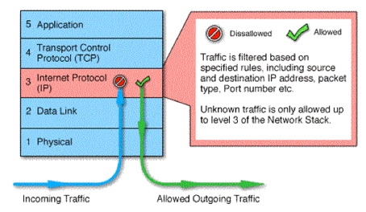
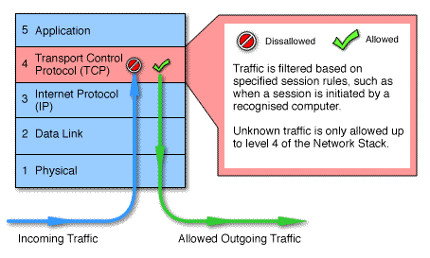
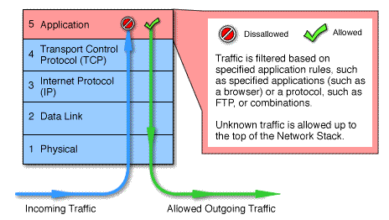
Packet Filtering vs Gateway vs Application-Level Firewall

Slide 16
SOCKS Circuit-Level Gateway
SOCKS v5 defined as RFC1928 to allow TCP/UDP applications to use firewall
Components:
  SOCKS server on firewall
  SOCKS client library on all internal hosts
  SOCKS-ified client applications
Client app contacts SOCKS server, authenticates, sends relay request
Server evaluates & establishes relay connection
UDP handled with parallel TCP control channel
Notes:
An example of a circuit-level gateway implementation is the SOCKS package; version 5 of SOCKS is defined in RFC 1928. The RFC defines SOCKS in the following fashion: “The protocol described here is designed to provide a framework for client-server applications in both the TCP and UDP domains to conveniently and securely use the services of a network firewall. The protocol is conceptually a "shim-layer" between the application layer and the transport layer, and as such does not provide network-layer gateway services, such as forwarding of ICMP messages.” SOCKS consists of the following components:
• SOCKS server, which runs on a UNIX-based firewall.
• SOCKS client library, which runs on internal hosts protected by the firewall.
• SOCKS-ified versions of several standard client programs such as FTP and TELNET. The implementation of the SOCKS protocol typically involves the recompilation or relinking of TCP-based client applications to use the appropriate encapsulation routines in the SOCKS library.
When a TCP-based client wishes to establish a connection to an object that is reachable only via a firewall it must open a TCP connection to SOCKS port 1080 on the SOCKS server system. The client authenticates, and then sends a relay request. The SOCKS server evaluates the request and either establishes the appropriate connection or denies it. UDP exchanges are handled in a similar fashion. In essence, a TCP connection is opened to authenticate a user to send and receive UDP segments, and the UDP segments are forwarded as long as the TCP connection is open.

Slide 17
Firewall Basing
Several options for locating firewall:
  Bastion host
  Individual host-based firewall
  Personal firewall
Notes:
It is common to base a firewall on a standalone machine running a common operating system, such as UNIX or Linux. Firewall functionality can also be implemented as a software module in a router or LAN switch. In this section, we look at some additional firewall basing considerations, including on a bastion host, individual host, personal firewall.

Slide 18
Bastion Hosts
Critical strong point in network
Hosts application/circuit-level gateways
Common characteristics:
  Runs secure O/S, only essential services
  May require user auth to access proxy or host
  There may be many proxy services
  Each proxy can restrict features, hosts accessed
  Each proxy small, simple, checked for security
  Each proxy is independent, can be uninstalled
Notes:
A bastion host is a system identified by the firewall administrator as a critical strong point in the network's security. Typically, the bastion host serves as a platform for an application-level or circuit-level gateway. Common characteristics of a bastion host:
• executes a secure version of its operating system, making it a trusted system.
• only essential services are installed on the bastion host. These include proxy applications such as Telnet, DNS, FTP, SMTP, and user authentication.
• may require additional authentication before a user is allowed access to the proxy services, and may require its own authentication before granting user access.
• each proxy is configured to support only a subset of the application’s command set.
• each proxy is configured to allow access only to specific host systems.
• each proxy maintains detailed audit information by logging all traffic, each connection, and the duration of each connection.
• each proxy module is a very small software package specifically designed for network security, hence is easier to check such modules for security flaws.
• each proxy is independent of other proxies on the bastion host, and can be uninstalled without affecting the operation of the other proxy applications.
• generally performs no disk access other than to read its initial configuration file.
• each proxy runs as a nonprivileged user in a private and secured directory on host.

Slide 19
Host-Based Firewalls
Used to secure individual host
Available in/add-on for many O/S
Filter packet flows
Often used on servers
Advantages:
  Tailored filter rules for specific host needs
  Protection from both internal/external attacks
  Additional layer of protection to org firewall when used with a standalone firewall
Notes:
A host-based firewall is a software module used to secure an individual host. Such modules are available in many operating systems or can be provided as an add-on package. Like conventional standalone firewalls, host-resident firewalls filter and restrict the flow of packets. A common location for such firewalls is a server. There are several advantages to the use of a server-based or workstation-based firewall:
• Filtering rules can be tailored to the host environment. Specific corporate security policies for servers can be implemented, with different filters for servers used for different application.
• Protection is provided independent of topology. Thus both internal and external attacks must pass through the firewall.
• Used in conjunction with standalone firewalls, the host-based firewall provides an additional layer of protection. A new type of server can be added to the network, with its own firewall, without the necessity of altering the network firewall configuration.

Slide 20
Personal Firewall
Controls traffic flow to/from PC/workstation
For both home or corporate use
May be software module on PC
Or in home cable/DSL router/gateway
Typically much less complex
Primary role to deny unauthorized access
May also monitor outgoing traffic to detect/block worm/malware activity
Notes:
A personal firewall controls the traffic between a personal computer or workstation on one side, and the Internet or enterprise network on the other side. Personal firewall functionality can be used in the home environment and on corporate intranets. Typically, the personal firewall is a software module on the personal computer. In a home environment with multiple computers connected to the Internet, firewall functionality can also be housed in a router that connects all of the home computers to a DSL, cable modem, or other Internet interface. Personal firewalls are typically much less complex than either server-based firewalls or standalone firewalls. The primary role of the personal firewall is to deny unauthorized remote access to the computer. The firewall can also monitor outgoing activity in an attempt to detect and block worms and other malware.
An example of a personal firewall is the capability built in to the Mac OS X. When the user enables the personal firewall in Mac OS X, all inbound connections are denied except for those the user explicitly permits. For increased protection, advanced firewall features may be available, such as: Stealth mode hides the Mac on the Internet by dropping unsolicited communication packets, making it appear as though no Mac is present. UDP packets can be blocked, restricting network traffic to TCP packets only for open ports. The firewall may also supports logging, an important tool for checking on unwanted activity.

Slide 21
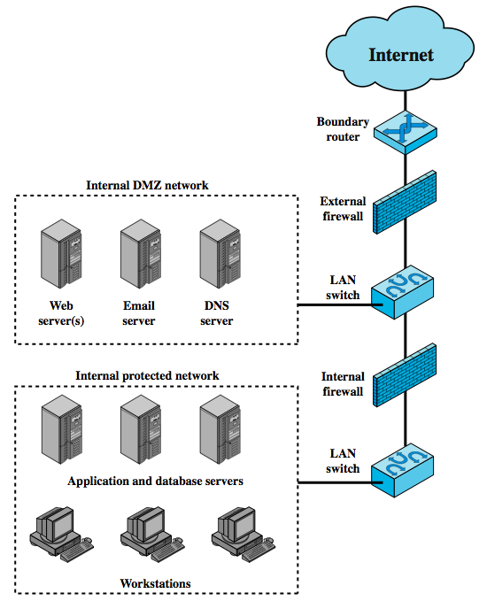
Firewall Locations
External firewall: protection for the
DMZ consistent with their need for
external connectivity
Internal firewall:
more stringent filtering capability
to provide protection from external
attacks
(b) provides two way protection wrt
the DMZ network
Notes:
A firewall is positioned to provide a protective barrier between an external, potentially untrusted source of traffic and an internal network. With that general principal in mind, a security administrator must decide on the location and on the number of firewalls needed. In this section, we look at some common options. Figure 9.3 suggests the most common distinction, that between an internal and an external firewall. An external firewall is placed at the edge of a local or enterprise network. One or more internal firewalls protect the bulk of the enterprise network. Between these two types of firewalls are one or more networked devices in a region referred to as a DMZ (demilitarized zone) network. Systems that are externally accessible but need some protections are usually located on DMZ networks.
The external firewall provides a measure of access control and protection for the DMZ systems consistent with their need for external connectivity. The external firewall also provides a basic level of protection for the remainder of the enterprise network.
In this type of configuration, internal firewalls server three purposes:
1. it adds more stringent filtering capability, compared to the external firewall, in order to protect enterprise servers and workstations from external attack.
2. it provides two-way protection with respect to the DMZ, protecting the remainder of the network from attacks launched from DMZ and protecting DMZ systems from attack from the internal protected network.
3. Multiple internal firewalls can be used to protect portions of the internal network from each other. Figure 6.5 in the text shows a configuration in which the internal servers are protected from internal workstations and vice versa.

Slide 22
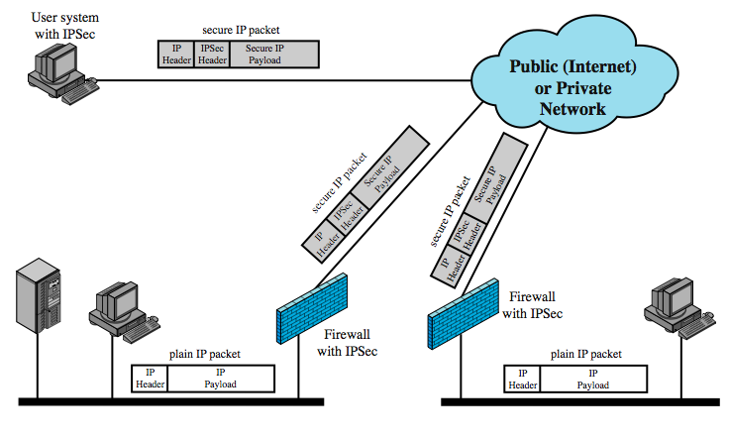
Virtual Private Networks
Encryption and similar services
but transparent to the user
Notes:
In today's distributed computing environment, the virtual private network (VPN) offers an attractive solution to network managers. In essence, a VPN consists of a set of computers that interconnect by means of a relatively unsecure network. Use of a public network exposes corporate traffic to eavesdropping and provides an entry point for unauthorized users. To counter this problem, a VPN is needed. In essence, a VPN uses encryption and authentication in the lower protocol layers to provide a secure connection through an otherwise insecure network, typically the Internet. VPNs are generally cheaper than real private networks using private lines but rely on having the same encryption and authentication system at both ends. The encryption may be performed by firewall software or possibly by routers. The most common protocol mechanism used for this purpose is at the IP level and is known as IPSec.
Figure 9.4 from the text shows a typical scenario of IPSec usage. An organization maintains LANs at dispersed locations. Nonsecure IP traffic is conducted on each LAN. For traffic offsite, through some sort of private or public WAN, IPSec protocols are used to encrypt and compress all traffic going into the WAN, and decrypt and decompress traffic coming from the WAN; authentication may also be provided. These operations are transparent to workstations and servers on the LAN. A logical means of implementing an IPSec is in a firewall, as shown in Figure 9.4. If IPSec is implemented in a separate box behind (internal to) the firewall, then VPN traffic passing through the firewall in both directions is encrypted. In this case, the firewall is unable to perform its filtering function or other security. IPSec could be implemented in the boundary router, outside the firewall. However, this device is likely to be less secure than the firewall and thus less desirable as an IPSec platform.

Slide 23
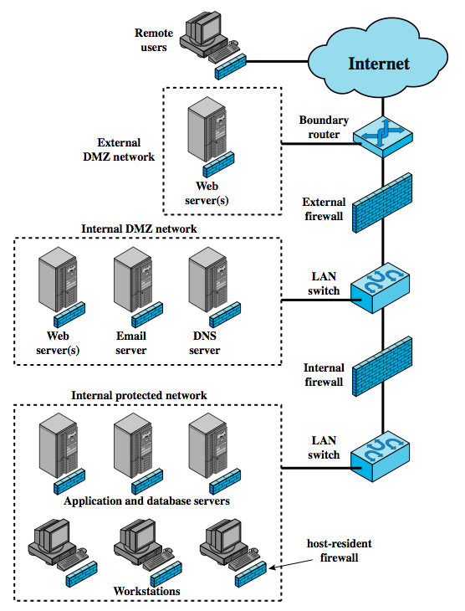
Distributed Firewalls
A combination of earlier firewalls
Host-resident firewall on 100s of
PCs plus standalone firewalls under
a central administration
Notes:
A distributed firewall configuration involves standalone firewall devices plus host-based firewalls working together under a central administrative control. Figure 9.5from the text suggests a distributed firewall configuration. Administrators can configure host-resident firewalls on hundreds of servers and workstation as well as configuring personal firewalls on local and remote user systems. Tools let the network administrator set policies and monitor security across the entire network. These firewalls protect against internal attacks and provide protection tailored to specific machines and applications. Standalone firewalls provide global protection, including internal firewalls and an external firewall, as discussed previously.
With distributed firewalls, it may make sense to establish both an internal and an external DMZ. Web servers that need less protection because they have less critical information on them could be placed in an external DMZ, outside the external firewall. What protection is needed is provided by host-based firewalls on these servers.
An important aspect of a distributed firewall configuration is security monitoring. Such monitoring typically includes log aggregation and analysis, firewall statistics, and fine-grained remote monitoring of individual hosts if needed.

Slide 24
Firewall Topologies
Host-resident firewall: personal firewall and firewall on servers (used alone or part of a defense in-depth)
Screening router: a single router between internal and external networks, e.g., SOHO apps)
Single bastion inline: single firewall device between an internal and external router (stateful or app proxies)
Single bastion T: similar to above but has a 3rd NIC on bastion to a DMZ (for medium to large organizations)
Double bastion inline: DMZ is between (for large organizations)
Distributed firewall configuration
Notes:
We can now summarize the discussion from Sections 9.4 and 9.5 to define a spectrum of firewall locations and topologies. The following alternatives can be identified:
• Host-resident firewall: This category includes personal firewall software and firewall software on servers, used alone or as part of an in-depth firewall deployment.
• Screening router: single router between internal and external networks with stateless or full packet filtering. Typical for small office/home office (SOHO) applications.
• Single bastion inline: single firewall device between an internal and external router (Fig 9.1a) .The firewall may implement stateful filters and/or application proxies. This is the typical firewall appliance configuration for small to medium-sized organizations.
• Single bastion T: Similar to single bastion inline but has a third network interface on bastion to a DMZ where externally visible servers are placed. Again, this is a common appliance configuration for medium to large organizations.
• Double bastion inline: Fig 9.3 illustrates this configuration, where the DMZ is sandwiched between bastion firewalls. This configuration is common for large businesses and government organizations.
• Double bastion T: Fig 6.5 illustrates this configuration. The DMZ is on a separate network interface on the bastion firewall. This configuration is also common for large businesses and government organizations and may be legally required in some cases.
• Distributed firewall configuration: Illustrated in Fig 9.5. This configuration is used by some large businesses and government organizations.

Slide 25
Summary
Introduced need for & purpose of firewalls
Types of firewalls
  packet filter, stateful inspection, application and circuit gateways
Firewall hosting, locations, topologies
Notes:
Chapter 9 summary.

